Slide 1
SLIDE SECTION
Internationalization for the Web
Victor Philip
www.floraladdress.com

Slide 2


ABOUT ME
Investor/trader, software developer (Java/OO), MBA Finance, startups, banking. From NYC.
Aside: trading stocks and options, traveling, learning conversational French and German, fly fishing.
Want to learn more: front-end skills,
NOT AN INTERNATIONALIZATION EXPERT
(but did some stuff)
i18n for the Web
Victor
Philip
@vphilipnyc

Slide 3
Understand scope and requirements
Best practices on implementation
Manage and scale

Slide 4
POLL
What percent of the internet is in English?

Slide 5
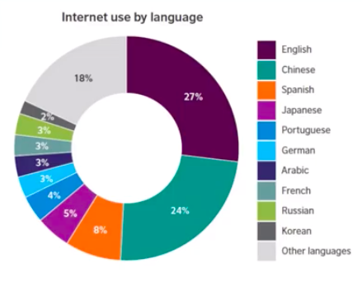
WHY GO I18n?
EXAMINE THE TREND
While the English language still dominates the web, increased internet penetration is growing the sheer volume of data in other languages.
CHINA AND INDIA UNDERREPRESENTED
Hundreds of millions of Chinese and Indian inhabitants are still without internet. There are an estimated 650,000,000 people in China alone that still do not have internet. This is also ignoring population growth.

Slide 6
13% of online shoppers
abandoned ecommerce websites
because products were displayed in a foreign currency*
EXAMINE THE TREND
While the English language still dominates the internet, increased internet penetration is growing the sheer volume of data in other languages.
* https://www.shopify.ca/blog/8484093-why-online-retailers-are-losing-67-45-of-sales-and-what-to-do-about-it

Slide 7

French Canadian
ENGLISH
FRENCH
Quarter Pounder with Cheese
“Royale with Cheese”
(Le Royale Cheese)
Quart de Livre avec Fromage

Slide 8
Language ≠ Locale
en_US
fr_FR
fr_CA
Quarter Pounder with Cheese
Le Royale Cheese
Quart de Livre avec Fromage

Slide 9
Localization ≠ Translation
Text Direction (Vertical, RTL) | Japanese, Arabic
Currency, Symbol Placement | en_US: € 123,456.78 de_DE: 123.456,78 € de_AT: € 123 456,78
Date and Time | 2/12/19
Masculine vs. Feminine | la biblioteca

Slide 10
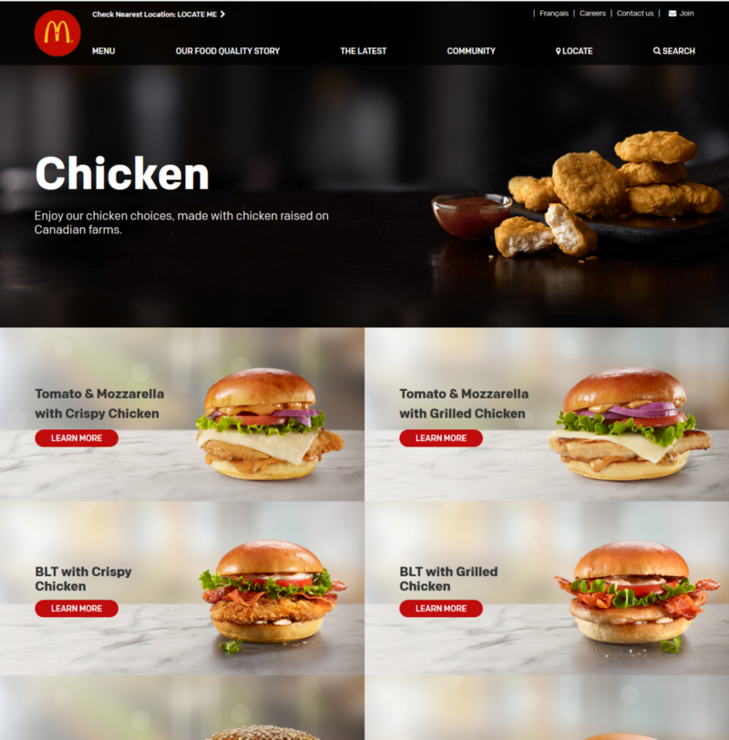
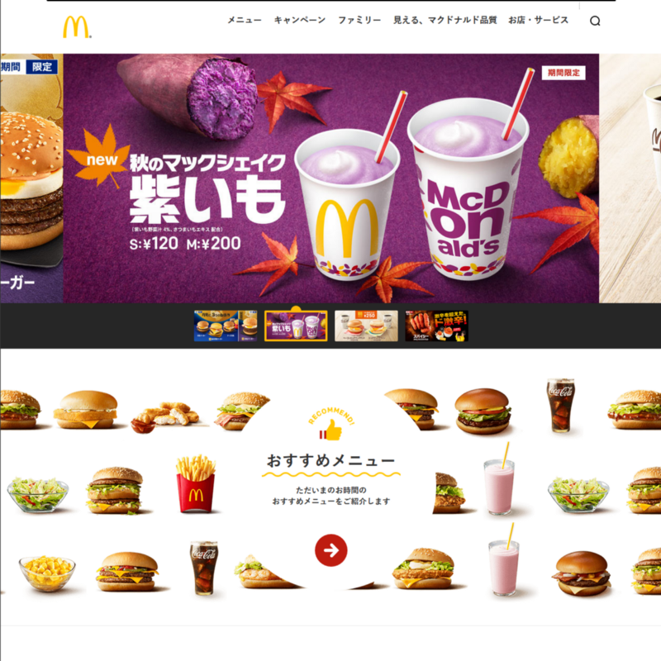

Slide 11
Localization vs. Internationalization
l10n
i18n
localization
Adapt your system for each locale (culture, language)
internationalization
Enabling your application to support localization.
Culture, language INDEPENDENT

Slide 12
THE “HOW”

Slide 13
Resource Files:
Client-Side Server-Side
.json
.yaml
.properties
.pot/.po → .mo

Slide 14
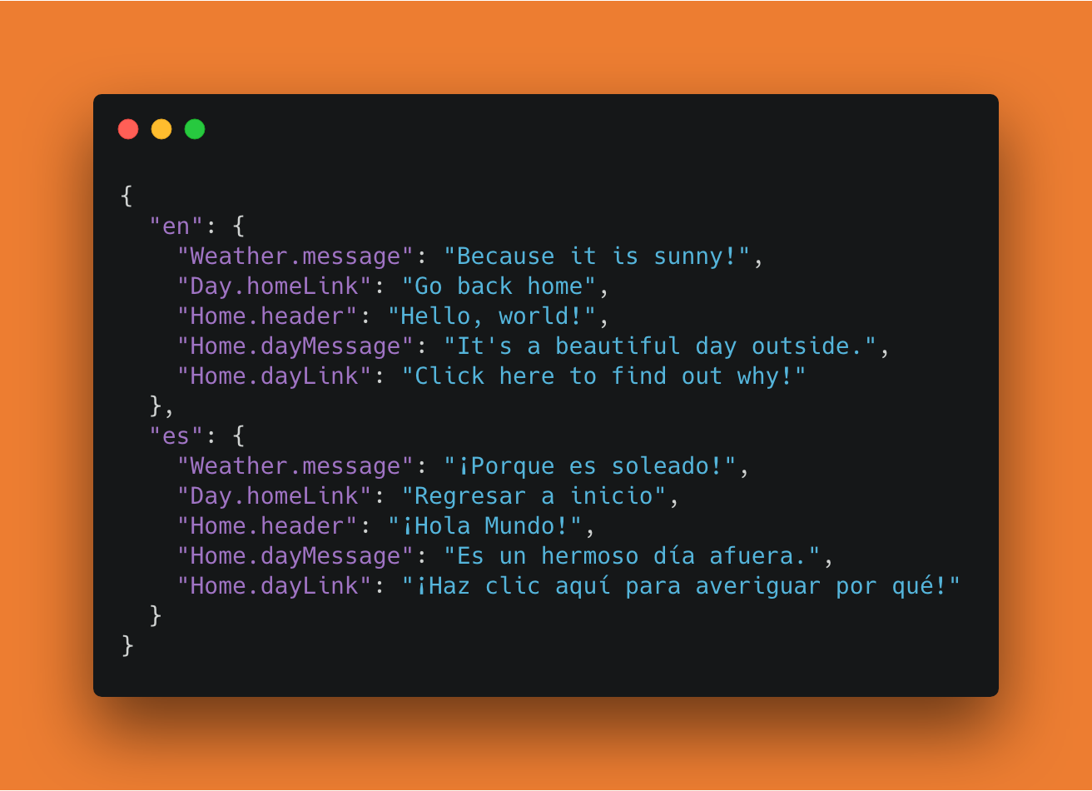
.json

Slide 15
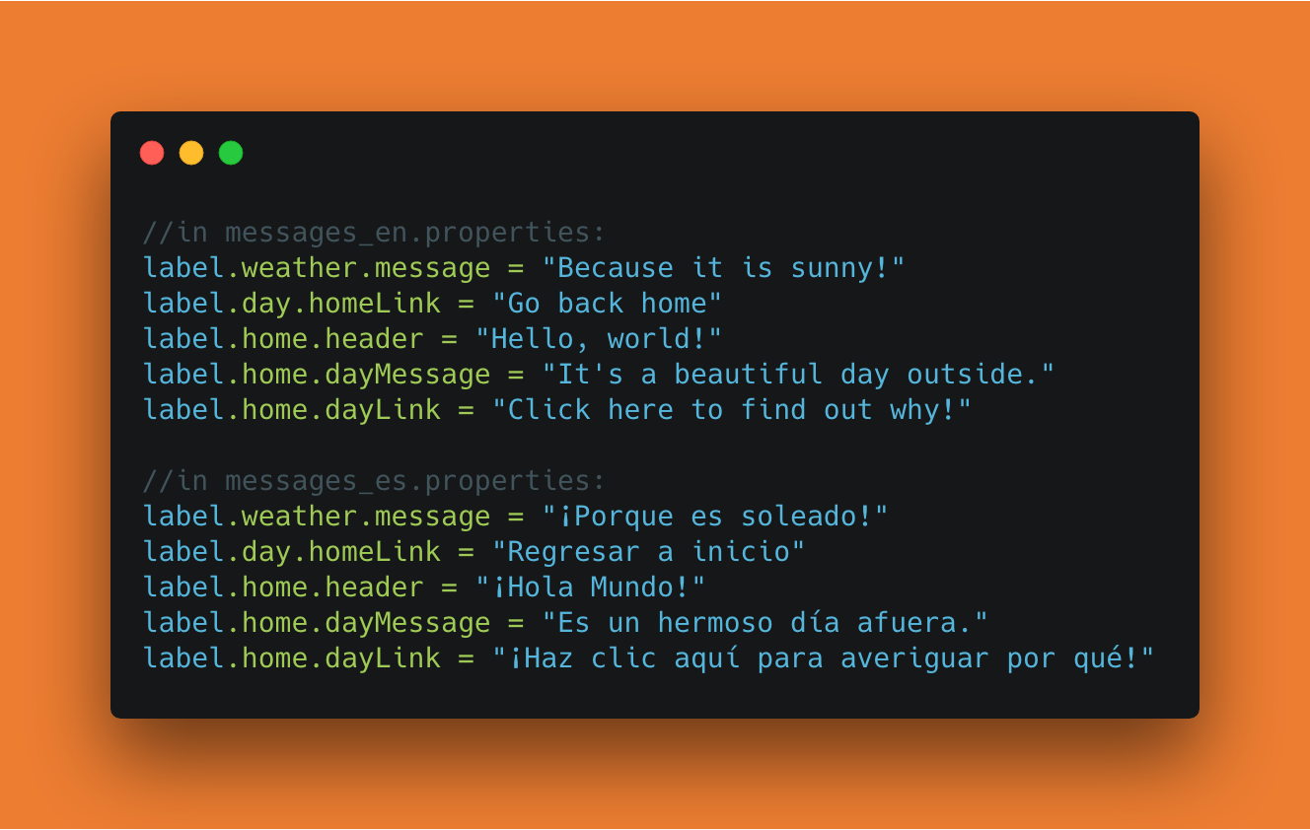
.properties

Slide 16
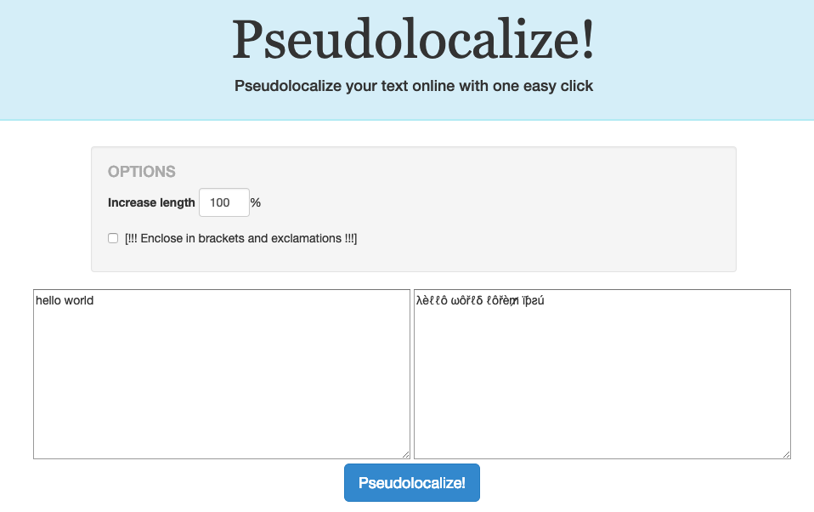
Pseudotranslation

Slide 17
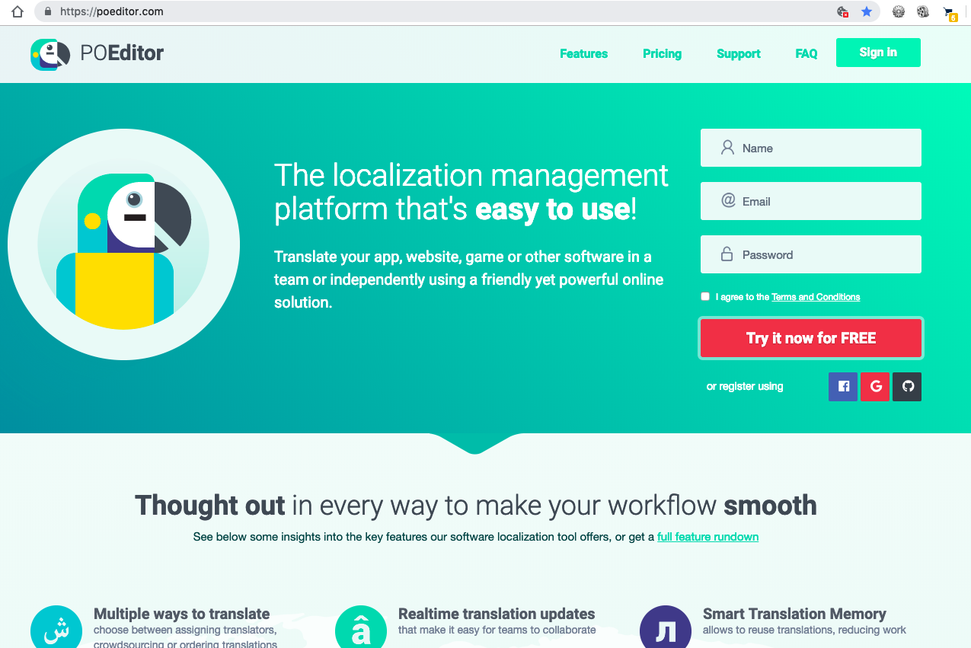
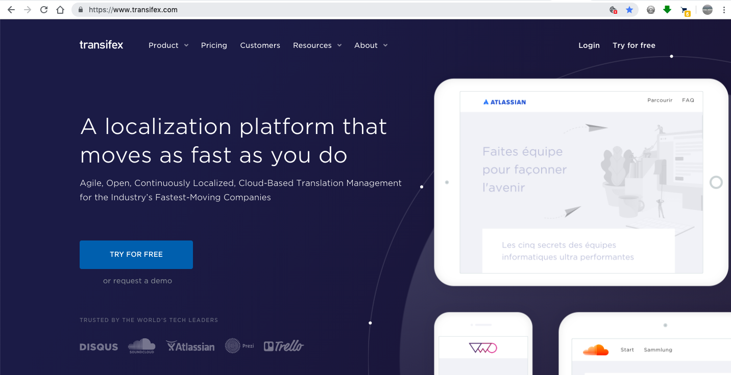
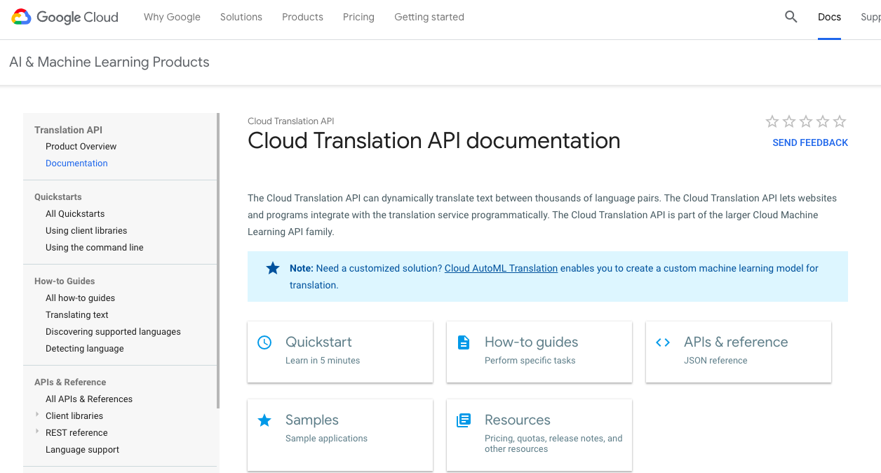
Translation Services

Slide 18
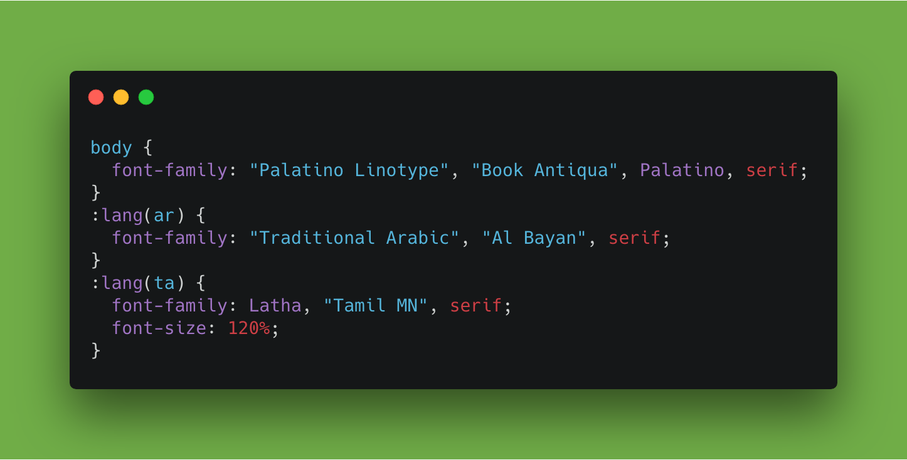
Client-Side Tips
Use :lang for font-families
Use <HTML lang>
Use UTF-8

Slide 19
Client-Side: RTL Languages
(Arabic, Hebrew, Farsi)
<HTML dir = “rtl”>
Defaults to left-to-right. so only need to set when using RTL languages specifically.
<HTML dir = “auto”>
This detects direction of the paragraph automatically.
text-align: left
text-align: start
margin-left: 2 em;
margin-inline-start: 2em;

Slide 20
Use libraries as much as possible
GlobalizeJS
gettext and various flavors (PHP/WordPress, Python)
Date.js and Moment.js

Slide 21
Server-Side: DEMO

Slide 22
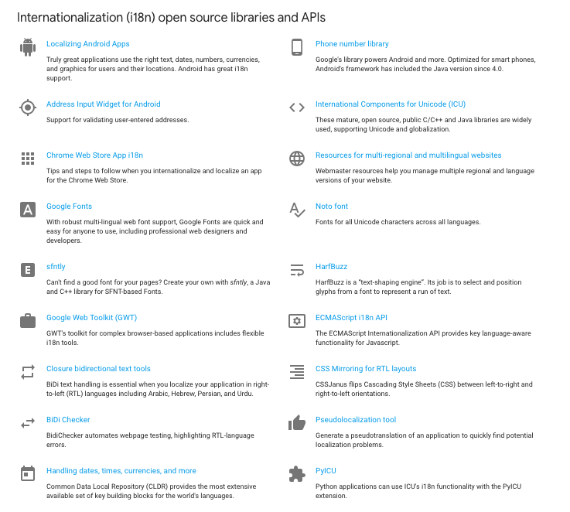
Google i18n Resources

Slide 23
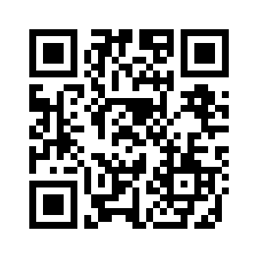
https://github.com/vphilipnyc/international
Vielen Dank

Slide 24
APPENDIX

Slide 25
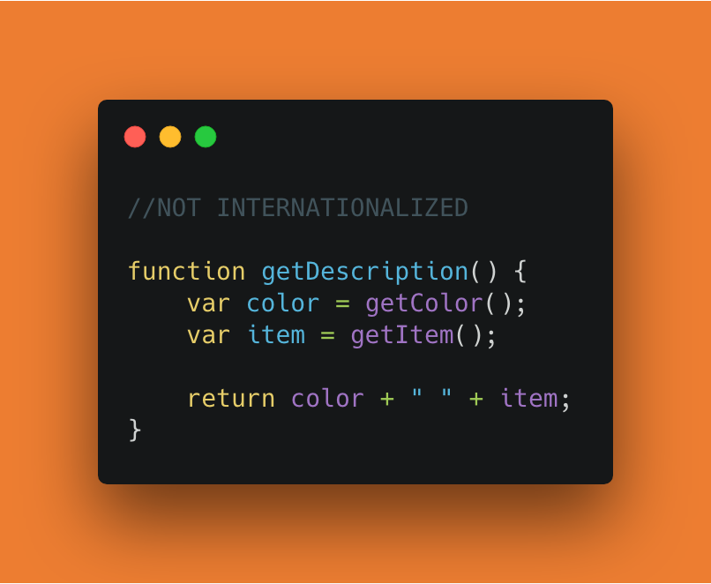
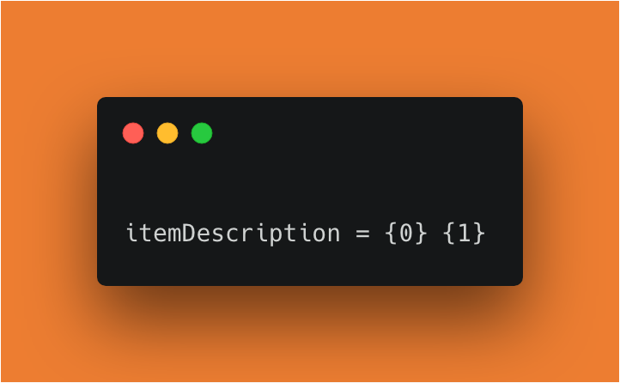
Use Parameterized Strings
en_US: “red crayon”
fr_FR: “crayon rouge”

Slide 26
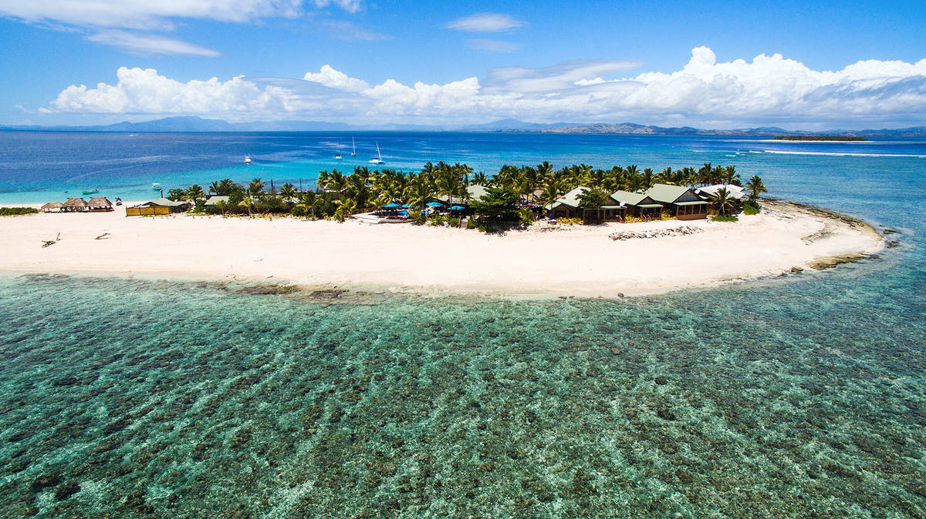
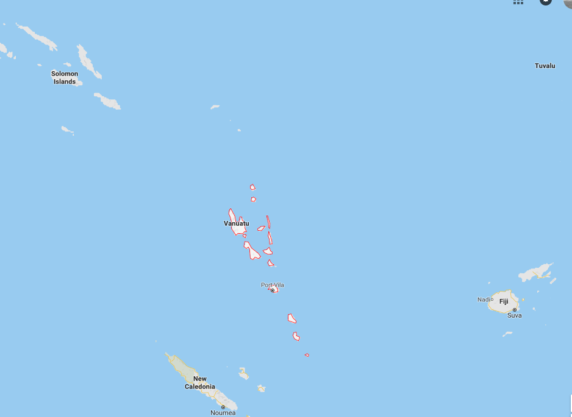
Vanuatu: Bislama

Slide 27
nambawan
(“number one”)

Slide 28
fren
(“friend”)

Slide 29
bad fren
(“enemy”)

Slide 30
Typically Unsupported
Pidgin languages
“grammatically simplified means of communication that develops between two or more groups that do not have a language in common: typically, its vocabulary and grammar are limited and often drawn from several languages..”
Creole languages
“a stable natural language that develops from the simplifying and mixing of different languages at a fairly sudden point in time: often, a pidgin transitioned into a full-fledged language.”
lexicon (or, roughly, the base or essential vocabulary – such as "run" but not "running") of a creole language is largely supplied by the parent languages.

